Slide 1
Interfacing Systemic Functional Grammars with Frame Semantics
Prepared for: 2018 International Systemic Functional Congress
26 July 2018
Presented by: Jeremy Dohmann Terry Patten Ceara Chewning Joe Campolongo
The views, opinions, and/or findings expressed are those of the author(s) and should not be interpreted as representing the official views or policies of the Department of Defense or the U.S. Government. This research was developed with funding from the Defense Advanced Research Projects Agency (DARPA).
Approved for Public Release, Distribution Unlimited.

Slide 2
Conventional realization rules
Adjacency: Role1 ^ Role2
Partition: Role1 | Role2
Conflation: Role1 / Role2
Expansion: Role (Subrole)
Lexification: Role = “text”
Preselection: Role : subnetwork_class

Slide 3
Using conventional realization rules for computational tasks
Parsing natural language
Information extraction
Natural language generation
Notes:
DON’T CALL THESE SYNTACTIC PARSES

Slide 4
Why conventional realization rules are insufficient
How should we interact with databases of propositional knowledge?
What about proper nouns?
In general how do we integrate world-knowledge?
How do we associate non-grammatical information with our parses? E.g. that John is Mary’s father or that a hammer is a tool
How do we enforce thematic filtering in our grammar? E.g. Enforcing that a verb such as “Taking” only accepts Sentient Agents and Objects which are Physical or that John can only felicitously issue a command to Bill if John is Bill’s superior
How do we compare information extracted from an SFG parse to external knowledge stored as propositions or in a database?
Notes:
Add bulleted examples

Slide 5
Interfacing with world-knowledge
Consider interacting with propositions such as
PROCESS(DeepRole1: Argument1, DeepRole2: Argument2,…)
… with annotations of the type
[TENSE, SEMANTIC_INFO, PROCESS_TYPE, ANIMACY, …]
We have two tasks:
Parse input sequences and compare them to entries in the database
Take entries in the database and generate sentences from them

Slide 6
Interfacing with world-knowledge
As long as all of the terminal symbols in the database are part of our vocabulary we could (inelegantly)…
Perform text generation using conventional realization rules
Convert propositions into a series of contextual stratum choices that are preselected down through (cluttered) networks
We can even take a parse in our grammar and construct a compositional proposition from the preselections and lexifications
Notes:
MENTION THAT THIS IS SEMANTIC STRATUM

Slide 7
Interfacing with world-knowledge
Introducing words that aren’t in our vocabulary would render these solutions untenable
E.g.: SLEPT(Agent:John, Location:The Plaza)
In general, world-knowledge:
Contains semantic content that our grammars should be agnostic of …
Because they are semantic in nature, or
Because they cannot be elegantly expressed (e.g. animacy, proper nouns, etc.)
Is stored in formats that don’t correspond to SFG parses

Slide 8
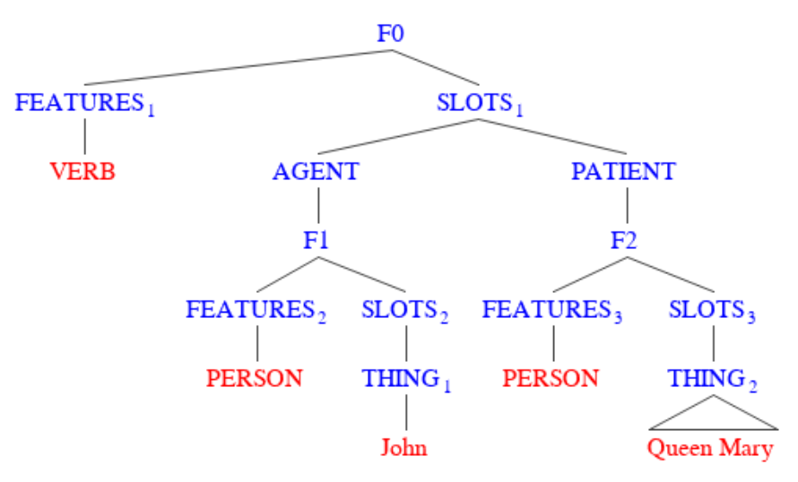
Our formalism
Frames consist of FEATURES and SLOTS
FEATURES are sets of strings describing syntactic/semantic/pragmatic features of frame
SLOTS are labeled edges pointing to subordinate FRAMES or TERMINAL VALUES (e.g. proper nouns)
This is critical for proper nouns OR storing semantic features which have no grammatical reflex

Slide 9
Why frames?
Based on cognitive theory that we store expectations about situations as compositional frame-like templates, making recognition tasks more feasible
Frames represent external semantics compositionally (in terms of feature-annotated trees)
Stores arbitrary semantic information independent of linguistic realization; thus resolves issues mentioned earlier about interfacing with world-knowledge
Allows us to represent information as instantiations of more general semantic templates

Slide 10
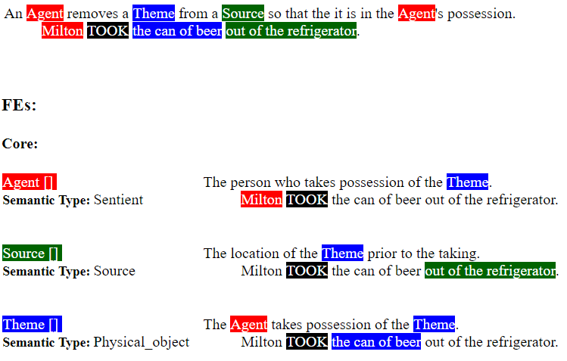
Why frames?
Easily integrated with extant natural language template databases
C.f.: FrameNet (https://framenet.icsi.berkeley.edu)
Taking

Slide 11
But how do we integrate frames with SFGs?
Two new realization rules:
Unification: Role @ FRAME_SLOT
Semselection:
Roled
Role $ SEMANTIC_FEATURE
Roleless
$ SEMANTIC_FEATURE
Notes:
Combine with tree slides

Slide 12
Why frames?
Taking

Slide 13
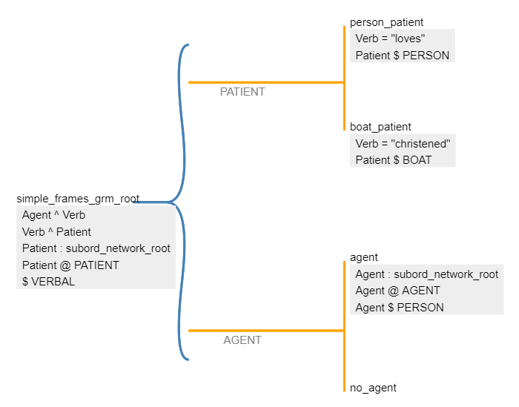
Integrating frames and SFGs: Generation

Slide 14
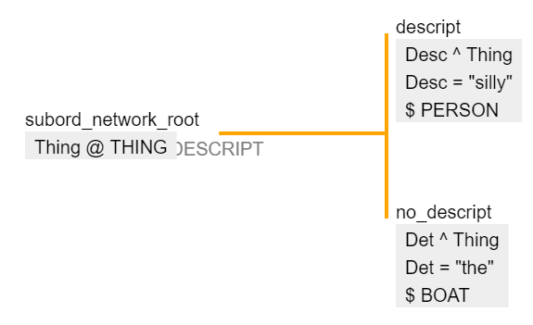
Generating “silly John” from F1

Slide 15
Generating “silly Queen Mary” from F2

Slide 16
Generating “silly John loves silly Queen Mary” from F0

Slide 17
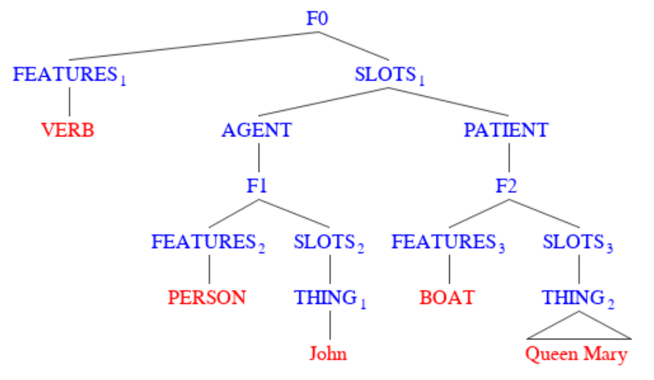
Generating “silly John christened the Queen Mary”

Slide 18
Generating “the Queen Mary” from F2

Slide 19
Formalism | Agreement | Inheritance | Types of Feature
Lexical Functional Grammar | F-structure constaints (f_1 = f_2) explicitly state that nodes 1 and 2 have equal features | Metavariables ↑ ↓ to refer to features of parent/self Explicitly project features as high as they need to be w/ chains of metavariable references and F-structure constraints | Arbitrary strings
Functional Unification Grammar | Constraints of the form: child1.f_x=child2.f_x Where f varies over classes and x over values | Assumes agreement information is projected from heads up to constituents Available for parents to impose constraints | Specific featural classes with specified values
Our Formalism | Constraints of the form: this = “FEAT” this.child = “FEAT” | Assumes agreement information is projected from heads up to constituents Available for parents to impose constraints | Arbitrary strings

Slide 20
Recap
Devise uniform model of representation for semantics interoperable with conventional external storage of semantics, e.g. FrameNet, propositional logic, databases
Create a compositional, Montagovian interpretation of a network traversal
Be flexible enough to handle the semantics of any user-defined language (whether it be natural language, gestural commands for a robot, or computer programming instructions)
Impose agreement constraints in a way well-motivated by current linguistic research

Slide 21
Charles River Analytics Points of Contact
Jeremy Dohmann Software Development Intern 617.491.3474 jdohmann@cra.com
Terry Patten Principal Scientist 617.491.3474 x582 tpatten@cra.com

